Slide 1

Medical Transcript Analysis
Angela Vales

Slide 2
Introduction
Dell’s Children’s Hospital provided medical transcripts on 8-10 patients and their families split across four transcripts
Analyzed medical transcript data regarding recovery journey after heart surgery

Slide 3
Method
Data was analyzed per transcript, meaning text data was not combined
Multiple analysis techniques included:
Sentiment Analysis
Topic Modeling (Latent Dirichlet Allocation (LDA))
Text Mining
Open AI

Slide 4
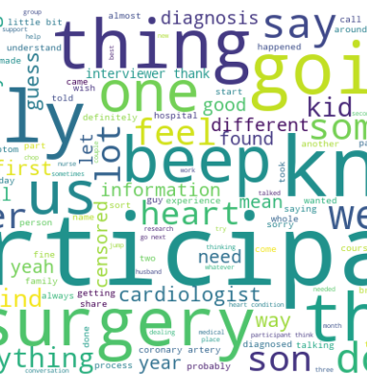
Results – Sentiment Analysis
Overview: Sentiment Analysis is a method to analyze text and determine whether the sentiment or emotional tone is positive, negative or neutral.
Across 4 transcripts, sentiment was positive
Patients/Parents generally regarded their journey as positive

Slide 5
Results – Topic Modeling (LDA)
Overview: Latent Dirichlet Allocation (LDA) classifies text in documents and the words per topic. LDA attempts to find topics the words in the document belongs to.
Excluded noise by tuning parameters and looked at 3 components
Themes between the four documents included frustration, curiosity, emotions, and data

Slide 6
Results – Open AI
Prompted Open AI to provide 5 themes for transcripts.
Major themes across transcripts included:
Communication and Keeping it Simple for medical language
Emotional Impact and Coping Mechanisms
Uncertainty About Future
Treatment Decisions/Lack of Information
Monitoring and Evaluation/Hope for the Future

Slide 7
Results – Text Mining
Transcripts were mined for gaps in care and outcome by looking for key words
Example gap phrases include deficiencies, lacking, gaps
Example outcomes phrases include healthy, harmed, improving, complications
For gaps in care there was a consensus that more information is needed regarding follow-up
Participants did not know what questions to ask their health care team and it would be helpful to see kids of the same age to give advice
Outcomes phrases were geared toward surgical decisions, quality of future life, and participants were moving on with life involved in sports and future studies.

Slide 8
Future Directions
A future direction to take regarding this analysis is to combine transcripts for analysis
There was an assumption that different cohorts might provide different contextual themes/dialogue flow
It would be interesting to also see change in themes if sampled at different intervals (before, after , 1 year follow-up)

